Slide 1


Digital Commerce Strategy
Enterprise eCommerce

Slide 2
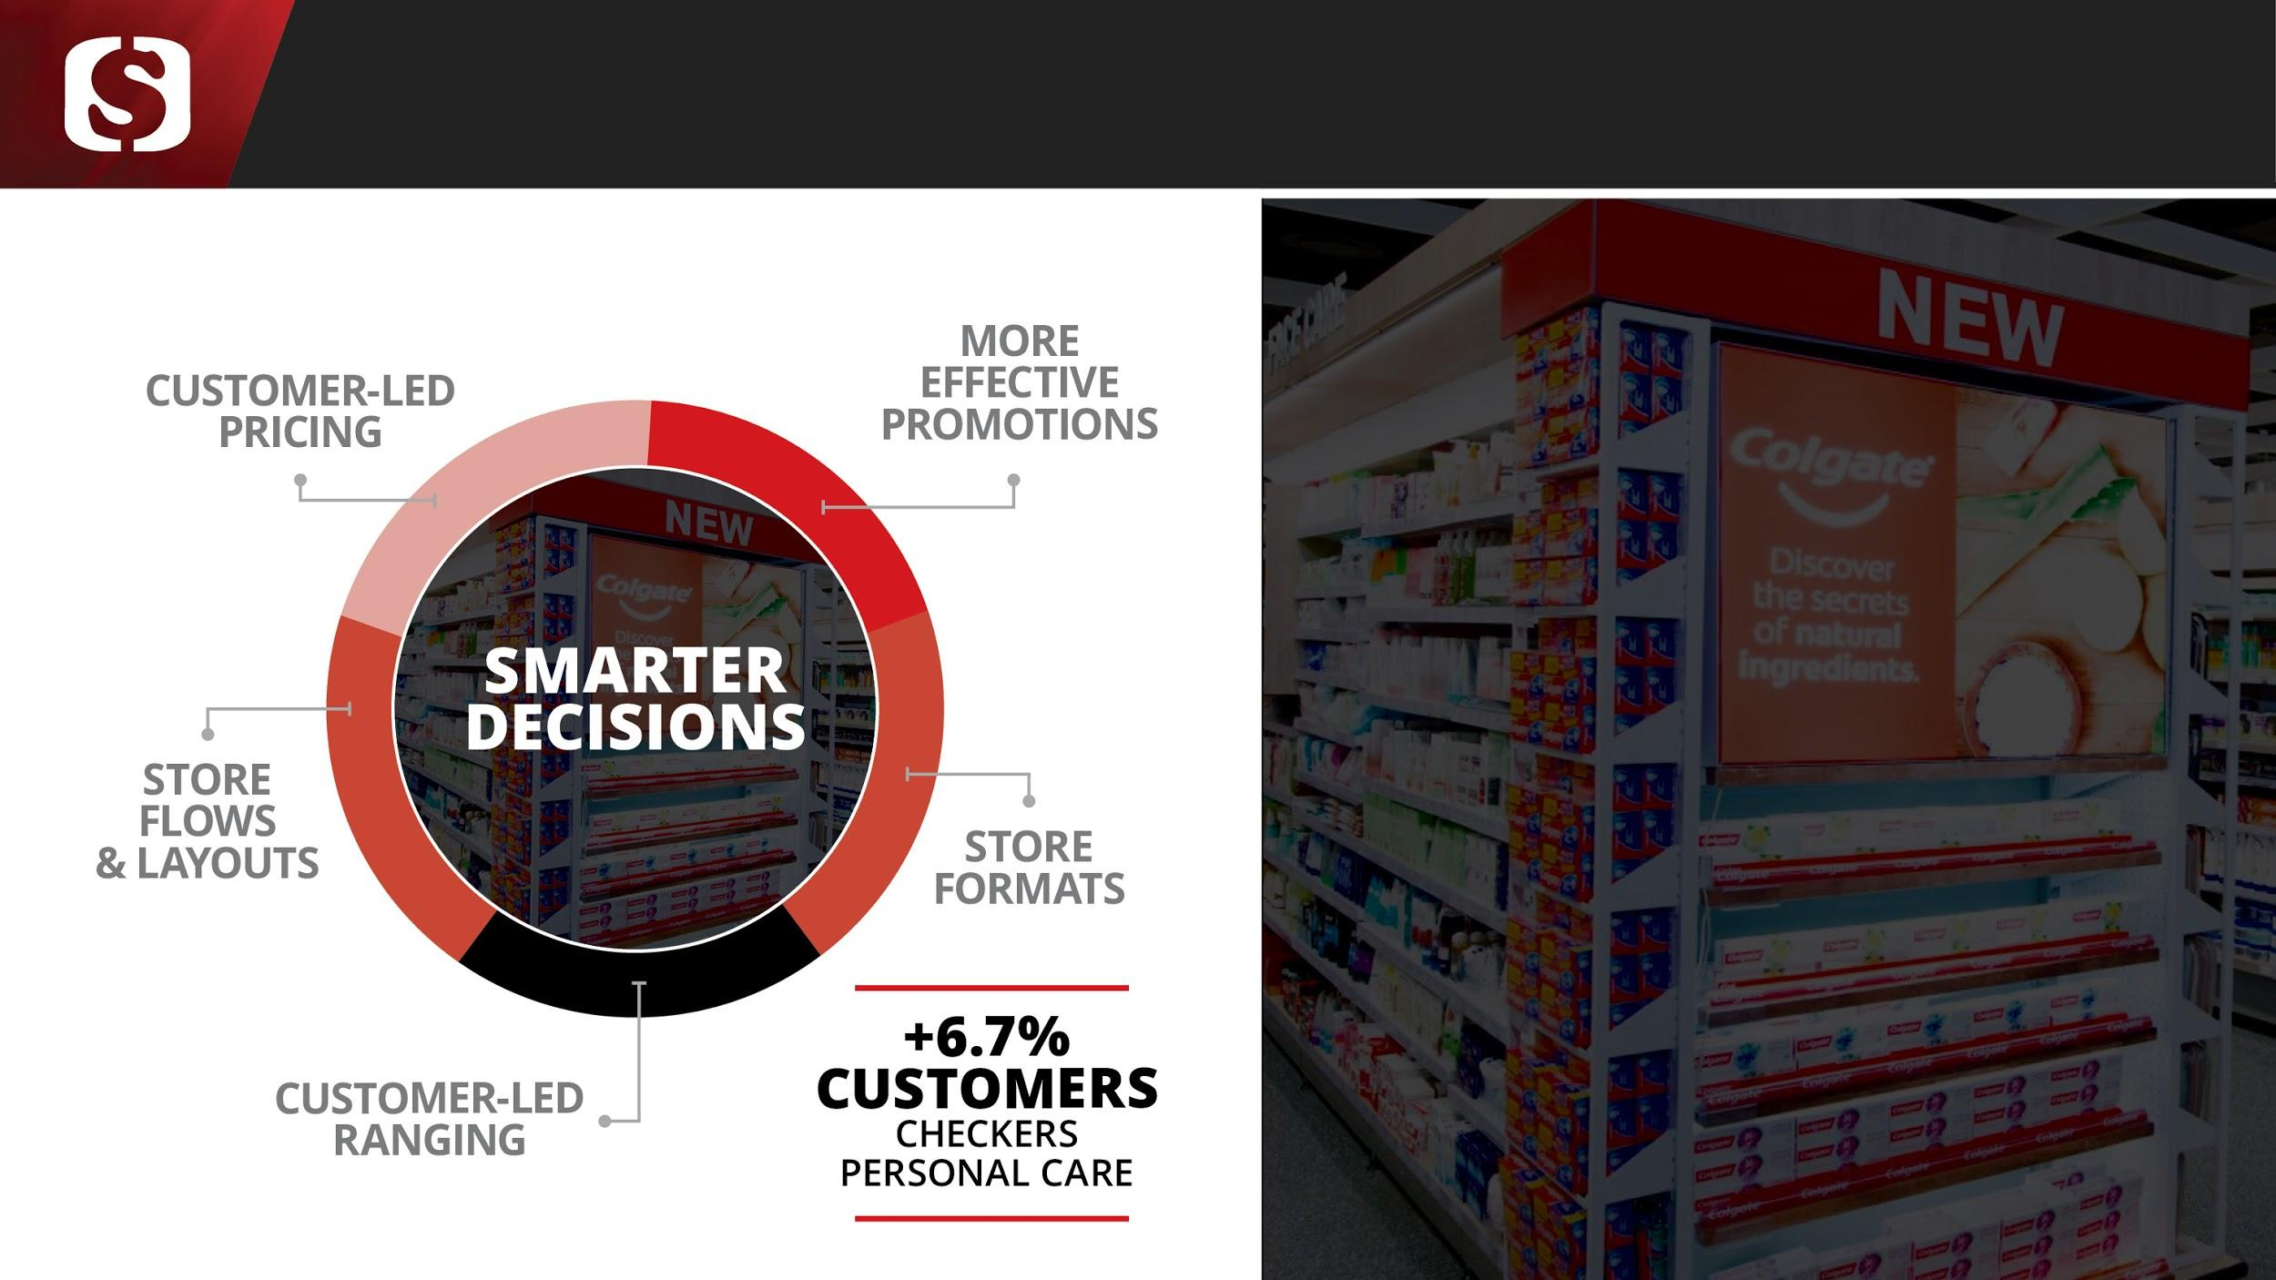
























Current Digital Commerce Technology Landscape (Current)
3rd Party Services
No Integration to SR
Business Unit
Checkers
Wine & Platters
CFS
Transpharm
House & Home
Computicket
Medirite
Sixty 60
Channels
Each UI has a different dev team 2 inhouse vs 6 3rd party
Web
Web
Web
Web
Money Market
Website
App
Web
App
Commerce
Product Catalogue
Basket
Search
Profile Management
SAP
Commerce
Nop
Commerce
iIntegrate
Magento
Custom
Health Window
On
Demand
Marconi
ERP / WMS
MS Navision
Positil
Argility
Unisolv
SAP
ERP
Payment
POS Retalix
eCentric
Positil
Account
VCS
eCentric
POS (Unisolv)
eCentric
eCentric
Account
eCentric
POS Retalix
Peach Payments
Fulfilment
MS Navision
Positil
Custom Pick App
Delivery
TrackMatic
TrackMatic
Custom Integrated 3rd Party
B2C
B2C
B2B / B2C
B2C
B2C
B2B
B2C

Slide 3



Current Digital Commerce Technology Landscape (2021-2022)
3rd Party Services
No Integration to SR
Business Unit
LS / PS / CFS
Transpharm
House & Home
Computicket
Medirite
Sixty 60
Channels
Each UI has a different dev team 2 inhouse vs 6 3rd party
Web
Web
Web
Web
Money Market
Website
App
Web
App
Commerce
Product Catalogue
Basket
Search
Profile Management
SAP
Commerce
Magento
Custom
Health Window
On
Demand
Marconi
ERP / WMS
MS Navision
Positil
Argility
Unisolv
SAP
ERP
Payment
eCentric
Positil
Account
VCS
eCentric
POS (Unisolv)
eCentric
Account
eCentric
POS Retalix
Peach Payments
Fulfilment
MS Navision
Positil
Custom Pick App
Delivery
TrackMatic
TrackMatic
Custom Integrated 3rd Party
B2C
B2C
B2B / B2C
B2C
B2C
B2B
B2C

Slide 4

Current Digital Commerce Technology Landscape (End State)
> 2023
3rd Party Services
No Integration to SR
Business Unit
LS / PS / CFS
Transpharm
House & Home
Computicket
Medirite
Sixty 60
Channels
Each UI has a different dev team 2 inhouse vs 6 3rd party
Web
Web
Web
Web
Money Market
Website
App
Web
App
Commerce
Product Catalogue
Basket
Search
Profile Management
SAP
Commerce
Custom
Health Window
On
Demand
Marconi
ERP / WMS
Shoprite ERP
Unisolv
SAP
ERP
Payment
Shoprite Financial Services
eCentric
POS (Unisolv)
eCentric
POS Retalix
Peach Payments
Fulfilment
Shoprite DOM
Custom Pick App
Delivery
On Demand / fulfilment Centres / Dop Ship / In store Pickup
Custom Integrated 3rd Party
B2C
B2C
B2B / B2C
B2C
B2C
B2B
B2C

Slide 5









Enterprise eCommerce Capabilities
Mobile
Online
Store
Call Center Sales
Advertising
Digital Commerce Services
Customer Support
Innovation
Merchandising
Internal Search / ABN / Customer Reviews / Gift Registry / Profile Management
Customer Relationship Management
Basket / Checkout / Payment
Stability
Rewards
Distributed Order Management
Enterprise Inventory Visibility
Analytics
Innovation
On Demand
B2C Warehouse
In Store Pickup
Supplier Drop Ship
Dark Store
Ship from Store
Last Mile
Brand Specific
Enterprise Services
Business Unit / Enterprise / 3rd Party
Notes:
Customer Engagement Micro Services:
Services that BU’s can develop to create a unique customer experience specific to their businesses
Other BU’s can then rebrand and reuse if applicable
E.g. ??
Core Services
Services that will be developed centrally to enhance scalability and reuse
E.g. common checkout enhances omni-channel integration and collection of customer data
Services centralised to enhance enterprise inventory visibility, enterprise customer visibility
E.g. DOM matches customer demand with fulfillment capabilities to provide best service at lowest cost
Simplify integration
BU specific requirements will still be incorporated
Fulfillment Services:
Allow innovation around fulfillment including 3rd party providers and suppliers
Fulfillment capabilities can be developed by BU’s but leveraged across the group through DOM
E.g. dark stores, drop ship

Slide 6
Enterprise eCommerce - Outcomes
The solution enables the following ShopriteX capabilities to the greater Enterprise
POPI compliant Customer Management through the enablement of CIAM
Integrated Customer Support with the use of SAPC4C
Consolidated Digital Marketing through SAP Marketing Cloud
Integration with the Rewards platforms for Checkers branded business units (CFS and LiquorShop)
Enterprise Reporting and a 360 view of the customer through Shoprite BI.
Shoprite Digital Advertising enablement through Rainmaker
Enterprise Digital Product Management utilising the Xtrasavings platforms
The solution accelerates existing business units by providing the following
A multitenant composable Enterprise eCommerce platform that is built for scale
A scalable rich API's for Business units to consume
Last mile capabilities for business units with warehouse integration, in store pickup and on demand integrations in the next year
Experience
Innovation
Enterprise Ecommerce API's
SAP Commerce (Digital Commerce)
Advertising
(Rainmaker)
Platforms
Product Info Management &
Merchandising
Stability
Customer Identity and Access Management (CIAM)
Enterprise Services
Customer Support
(C4C)
Marketing
(SAP Marketing Cloud)
Rewards
(Xtrasavings)
BI
and
Analytics
Innovation
B2C Warehouse
In Store Pickup
(Phase 2)
On Demand
(Phase 2)
Fulfilment
Notes:
Customer Engagement Micro Services:
Services that BU’s can develop to create a unique customer experience specific to their businesses
Other BU’s can then rebrand and reuse if applicable
E.g. ??
Core Services
Services that will be developed centrally to enhance scalability and reuse
E.g. common checkout enhances omni-channel integration and collection of customer data
Services centralised to enhance enterprise inventory visibility, enterprise customer visibility
E.g. DOM matches customer demand with fulfillment capabilities to provide best service at lowest cost
Simplify integration
BU specific requirements will still be incorporated
Fulfillment Services:
Allow innovation around fulfillment including 3rd party providers and suppliers
Fulfillment capabilities can be developed by BU’s but leveraged across the group through DOM
E.g. dark stores, drop ship

Slide 7











Enterprise Architecture - MVP
Web Storefronts
Mobile Applications
Backoffice Applications
Assisted Sales
In Store
3rd Parties
Experience
API Service Gateway
API
API
API
API
API
API
API
API
API
Product Information Management
Search and Merchandising
CMS
Cart and Checkout
Order Management
Customer
Identity and Auth
Payment
Marketplace
Packaged Business Capabilities (PBCs)
Service
Datastore
Datastore
Datastore
Datastore
Datastore
Datastore
Datastore
Datastore
Datastore
Integration Hub
CRM
ERP
Analytics and AI
Finance
BI & Reporting
Loyalty Engine
Data Abstraction
POS
WMS
Payment Service Provider
Digital Asset Management

Slide 8
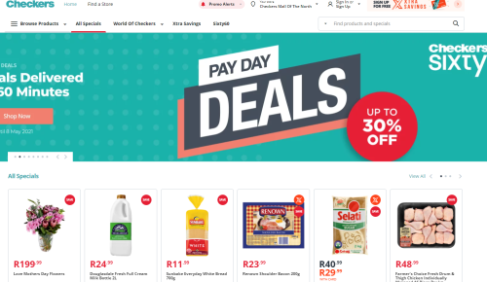
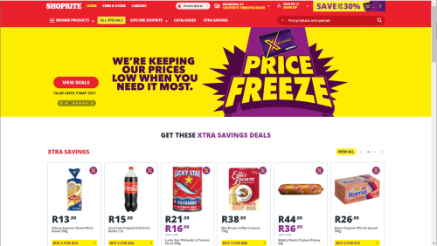


Digital Commerce Landscape - Platforms
Ecommerce Innovation Stream
Checkers 365 Website
Experience
Checkers.co.za / Shoprite.co.za
B2B Storefronts and Progressive Web App
Sixty60 and Checkers 365 app
Enterprise Rewards Platform and Enterprise PIM
Enterprise eCommerce Platform
On demand Fulfillment
API
API
API
API
API
API
API
Product Information Management
Search and Merchandising
CMS
Search and Merchandising
CMS
Cart and Checkout
Order Management
/ Picking
Platforms
Datastore
Datastore
Datastore
Datastore
Datastore
Datastore
Datastore
Integration Hub
Analytics and AI
BI & Reporting
Payment Service Provider
POS
Enterprise Services
Customer
CRM

Slide 9
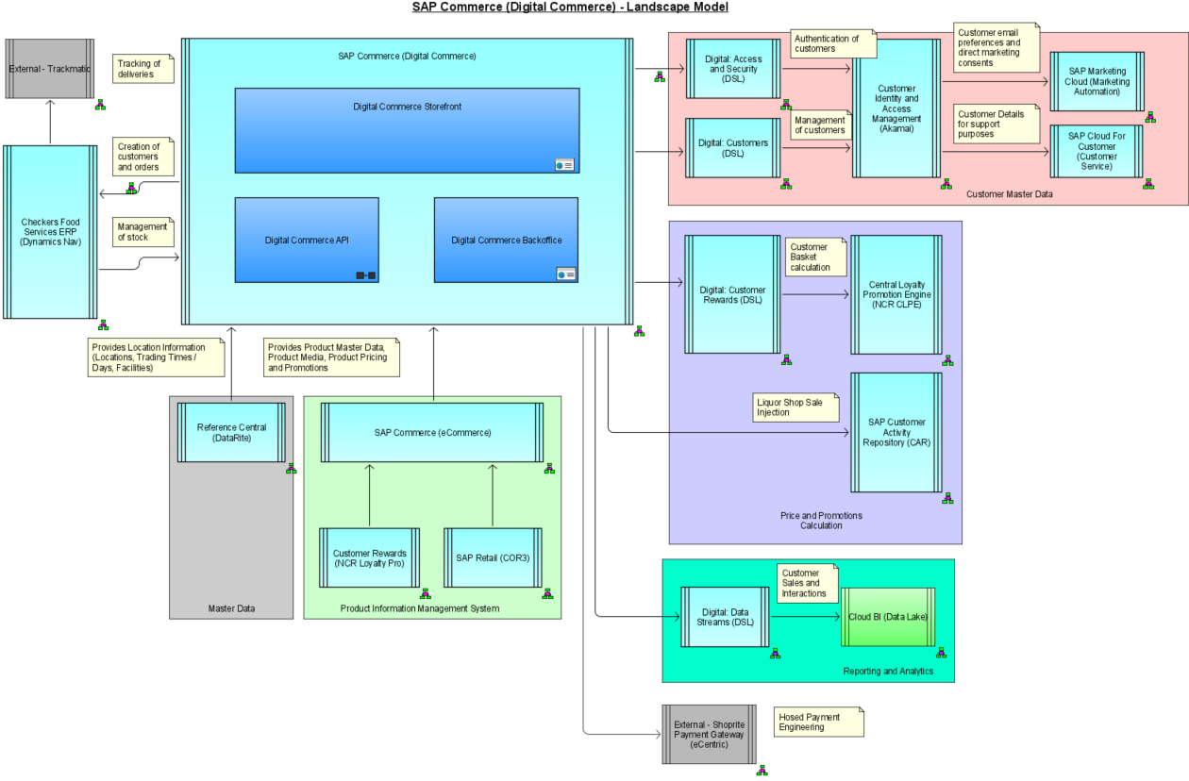
Landscape

Slide 10
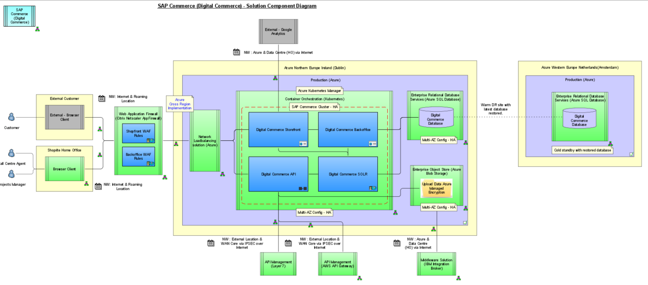
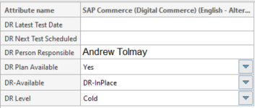
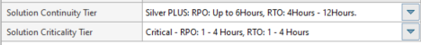
Disaster Recovery
Azure Site Recovery
Hendrick Kruger (Senior Azure) ,Willem Roos

Slide 11
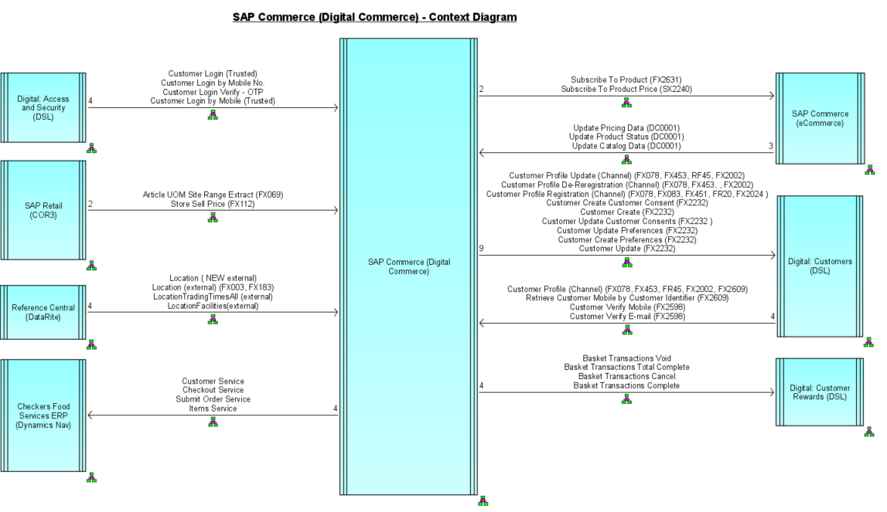
Disaster Recovery

Slide 12
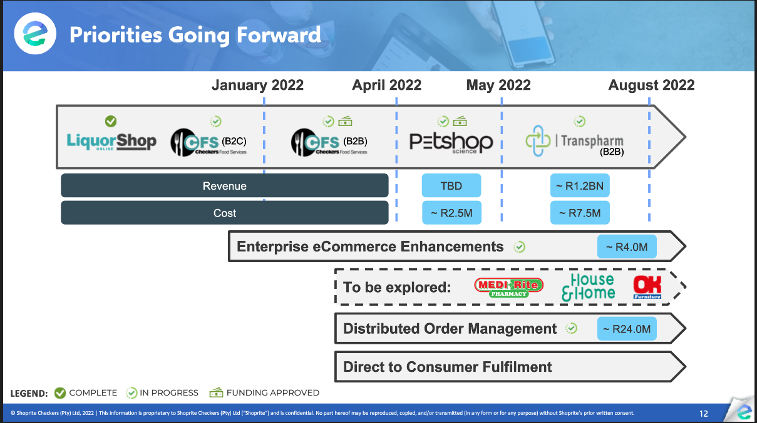
Digital Commerce Landscape - Platforms

